Slide 1
JQUERY UI

Slide 2


Slide 3
BACKGROUND
JQuery UI is a JavaScript library used for user interface interactions, effects, widgets, and themes.
Most of its properties are found in other libraries as well but JQuery UI is mainly popular for its interaction functions like draggable() and droppable().
Some JQuery UI functions overlap some of the functions of standard JQuery.
The documentation can be found here https://jqueryui.com/.

Slide 4
IMPORTING
The preferred way to import is to use the npm install command.
Another way is to insert the CSS and JavaScript links(shown below) on the index.html file:
<link rel='stylesheet' href='https://ajax.googleapis.com/ajax/libs/jqueryui/1.11.2/themes/smoothness/jquery-ui.css'>
<script type="text/javascript" src='https://ajax.googleapis.com/ajax/libs/jqueryui/1.11.2/jquery-ui.min.js'></script>

Slide 5
DRAGGABLE
Elements can be dragged around by assigning a .draggable() function.
This is useful for drag and drop operations often seen on data tables and graphical trees.

Slide 6
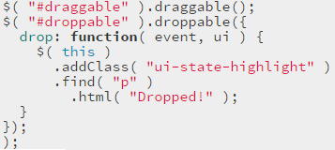
DROPPABLE
The .droppable() function can be used to trigger a function when an element is dropped in a certain location.
It’s common to add an item to a new list or change a style when an item has been dropped.

Slide 7
RESIZABLE
It’s often requested to have certain elements on a page be resized by dragging.
To achieve this, the .resizable() function can be applied.

Slide 8
SELECTABLE
Selectable can be used to change styles on items that are selected.

Slide 9
SORTABLE
Sortable can be used to re-arrange elements when elements are dragged and dropped.

Slide 10
MODIFYING CLASSES
In JQuery UI, classes can be added, removed, switched, or toggled very easily. This is a task required very frequently in full-stack development.
To add a class, the .addClass() can be added to an element. This is often used to add error styles to invalid textboxes.
To remove a class, the .removeClass() can be used.
To switch a class, the .switchClass() can be used, providing the existing class to switch as the first argument, and the new class as the second argument.
To toggle a class, the .toggleClass() can be used, to alternate between the same 2 classes by clicking a button.

Slide 11

ANIMATE
Elements can also be animated using the .animate() function.
Styles, sizes, and properties can all be transitioned as needed.

Slide 12
HIDE / SHOW
Hide/Show properties can be used similar to regular JQuery but added properties can be applied to give it more interaction.
For instance, the element can be animated to bounce, slide, fade,…etc.

Slide 13
EFFECT
The .effect() function provides a series of built-in animations that might be useful for a full-stack application.
Some of these include bouncing or pulsate, when trying to draw attention to an element of interest.
It’s best to experiment with these effects by going to the documentation site.

Slide 14
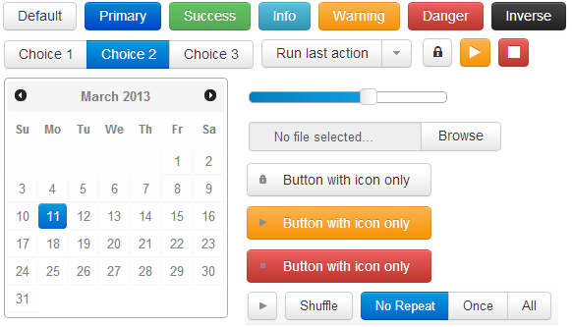
WIDGETS
JQuery UI widgets are similar to widgets offered by other libraries like Vuetify and Boostrap.
When picking widgets for an app, it’s important to stick to one library to maintain consistency throughout an app.

